Slide 1
System Analysis and Design CT026-3-1
Planning (Part 2 of 2)

Slide 2
Topic & Structure of The Lesson
Define project scope and project objectives
Describe various scheduling tools, including Gantt charts and PERT/CPM charts

Slide 3
Learning Outcomes
By the end of this module, YOU should be able to:
Defining Project Scope and Objectives
Project Scheduling

Slide 4
Key terms you must be able to use
If you have mastered this topic, you should be able to use the following terms correctly in your assignments and exams:
Project Scope
Project Objectives
Project Scheduling
Gantt Chart

Slide 5
Defining Project Scope
Determining the project scope means defining the specific boundaries, or extent, of the project. For example:
Very general:-
Payroll is not being produced accurately.
The project scope is to modify the accounts receivable system.
Very specific:-
Overtime pay is not being calculated correctly for production workers on the second shift at the Yorktown plant.
The project scope is to allow customers to inquire online about account balances and recent transactions.

Slide 6
Defining Project Scope
Some analysts find it helpful to define project scope by creating a list with sections:
Must Do
Should Do
Could Do
Won’t Do
reviewed later, during the systems analysis phase, when the systems requirements document is developed.
Projects with very general scope definitions are at risk of expanding gradually – project scope creep.
Use a graphical model that shows the systems, people, and business processes that will be affected.
Boundaries of the preliminary investigation.

Slide 7
Defining Project Scope
Along with defining the scope of the project, you need to identify any constraints on the system - requirement or condition that the system must satisfy or an outcome that the system must achieve.
A constraint can involve hardware, software, time, policy, law, or cost. For example:
The system must operate with existing hardware, that is a constraint that affects potential solutions.
The order entry system must accept input from 15 remote sites.
The human resources information system must produce statistics on hiring practices.
The new Web site must be operation by March 1.

Slide 8
Defining Project Objectives
Problem Statement or issues are followed by a series of objectives, or goals that match the issues point by point. Issues are the current situation; objectives are the desired situation.
The objectives may be very specific or worded using a general statement.
At times the analyst may have to do a follow-up interview to obtain more precise information about the objectives.

Slide 9
Defining Project Objectives
After the objectives are stated, the relative importance of the issues or objectives must be determined.
The identification of the most critical objectives is best done by users (with the support of analysts), because users are domain experts in their business area and in how they work best with technologies in the organization.
One technique is to ask the users to assign a weight for each issue or objective of the first draft of the problem definition.
The problem definition issues and objectives are resequenced in order of decreasing importance
Each objective is used to create user requirements.

Slide 10
Defining Project Objectives
Examples of Objectives:
Provide a Web system for customers to obtain pricing information and place orders.
Create or purchase a human resources system with a scheduling component.
After customers have signed an event contract, provide them with Web access to their account and a means for them to update the number of guests. Notify management of changes.
Provide a means to determine overall quantities of supplies for events occurring within a concurrent time frame.
Provide a system for communicating changes to key personnel at event facilities.
Store all event data and make summary information available in a variety of formats.

Slide 11
Project Management Tools & Techniques
GANTT Chart
a horizontal bar chart that graphically displays the time relationships between the different tasks in a project
effective when seeking to communicate schedule

Slide 12
Gantt Chart
Horizontal axis : Time and duration
Vertical axis : Activities - arranged from top to bottom in the order of their start date.
Horizontal position : start and end of the activity.
Length : Duration
Darkened portion : part of the activity that has been completed
“c” is marked when the activity is fully completed
Gantt Chart : It does not indicate activity dependencies

Slide 13
Gantt Chart
black bars – summary tasks – project phases
red bars – tasks that are critical to the schedule – any extension to the duration will delay other tasks
blue bars – tasks that are not critical to the schedule – they have slack time – delays will not affect other tasks & project as a whole
red arrows – prerequisites between two critical tasks
blue arrows – prerequisites between two non-critical tasks
teal diamonds – milestones – signifies the end of some significant task / deliverable

Slide 14
Gantt Chart
WBS – Work breakdown structure
The process of dividing the project into manageable tasks and logically ordering them to ensure a smooth transition between tasks
hierarchical decomposition of project into phases, activities & tasks

Slide 15
Gantt Chart
Decomposition is as follows :
1 Phase 1 of the project
1.1 Activity 1 of Phase 1
1.1.1 Task 1 of Activity 1 in Phase 1
1.1.2 Task 2 of Activity 1 in Phase 1
1.2 Activity 2 of Phase 1 ...
2 Phase 2 of the project ...

Slide 16
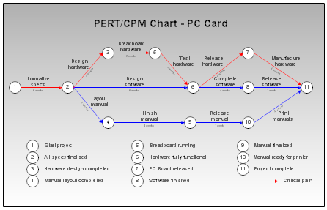
PERT Chart

Slide 17
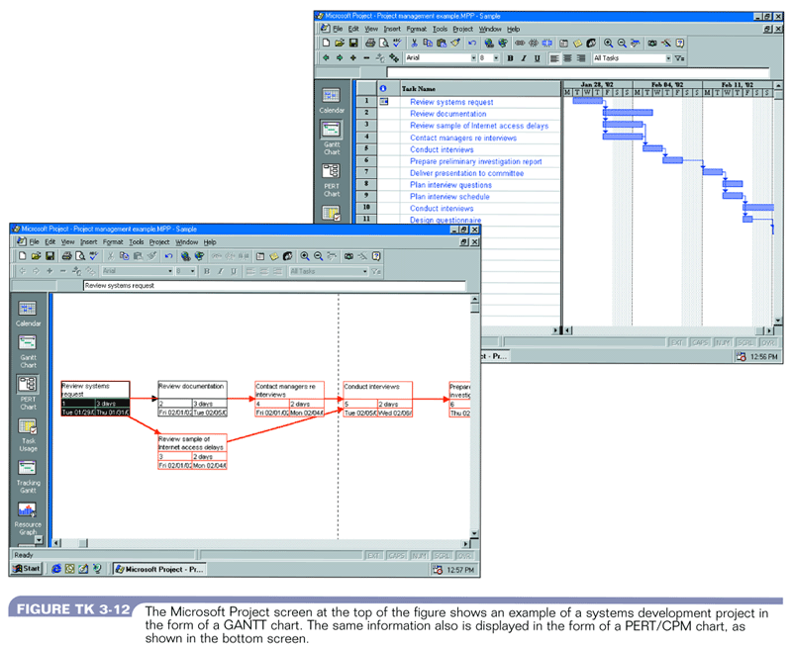
Project Management Software - MsProject

Slide 18
Keys to project success
Successful systems must :
Satisfy business requirements
Meet users’ needs
Stay within budget
Be completed on time

Slide 19
Some reasons for project failure
Unclear requirements, targets, or scope
Shortcuts or sloppy work
Poor design choices
Insufficient testing or test procedures
Lack of software change control
Changes in culture, funding or objectives
Unrealistic cost estimates
Poor monitoring and control of progress
Inadequate reaction to early signs of problems
Failure to recognize activity independencies
Personality conflicts and employee turnover

Slide 20
Quick Review Question
What is a project scope?
What tools can we use to help project planning?

Slide 21
Summary of Main Teaching Points
Determining the project scope means defining the specific boundaries, or extent, of the project.
Problem Statement or issues are followed by a series of objectives, or goals that match the issues point by point. Issues are the current situation; objectives are the desired situation.
The objectives may be very specific or worded using a general statement.
Gantt Chart/PERT Chart is used in Project Scheduling to display the time relationships between the different tasks in a project.

Slide 22
Question and Answer Session
Q & A

Slide 23
What we will cover next
Analysis
Requirement Gathering Techniques
Types of Requirements

Slide 24
References
Essential Reading
• Satzinger,J.W., Jackson,R.B., Burd,S.D. (2016). Systems Analysis and Design in a Changing World. 7th ed. Cengage Learning. ISBN: 1305117204 • Valacich,J.A., George,J. (2016). Modern Systems Analysis and Design. 8th ed. Pearson. ISBN: 0134204921
Suggested Reading
• Schwalbe,K. (2016). Information technology project management. 8th ed. Course Technology. ISBN: 9781285452340
K.E. Kendall, J.E. Kendall (2014), Systems Analysis and Design 9th Edition, Pearson; ISBN: 0133023443

